Slide 1
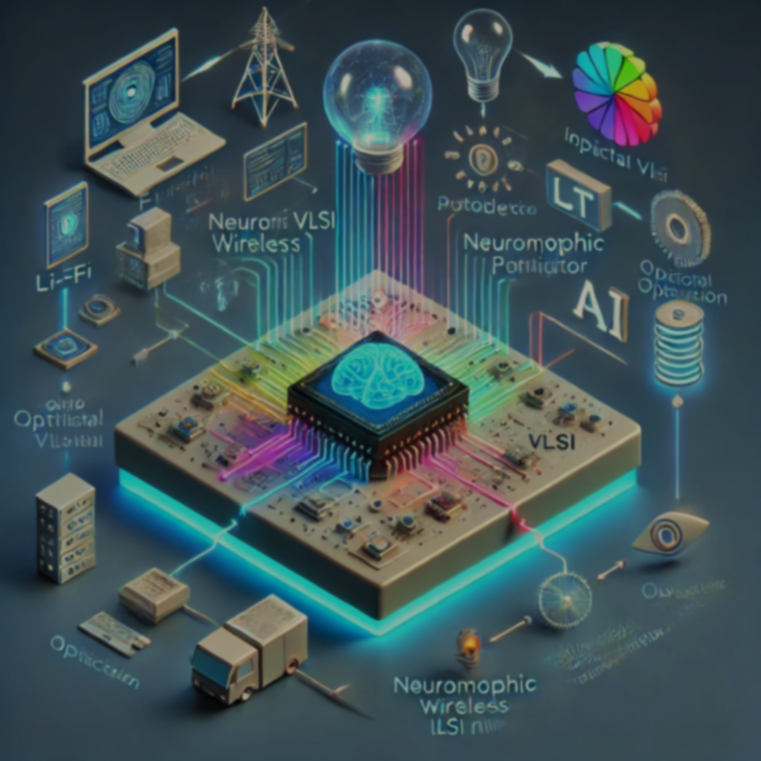
Neuromorphic VLSI For Intelligent Li-Fi Networks
Presented by:-
V. Sreeja
V. Sneha

Slide 2
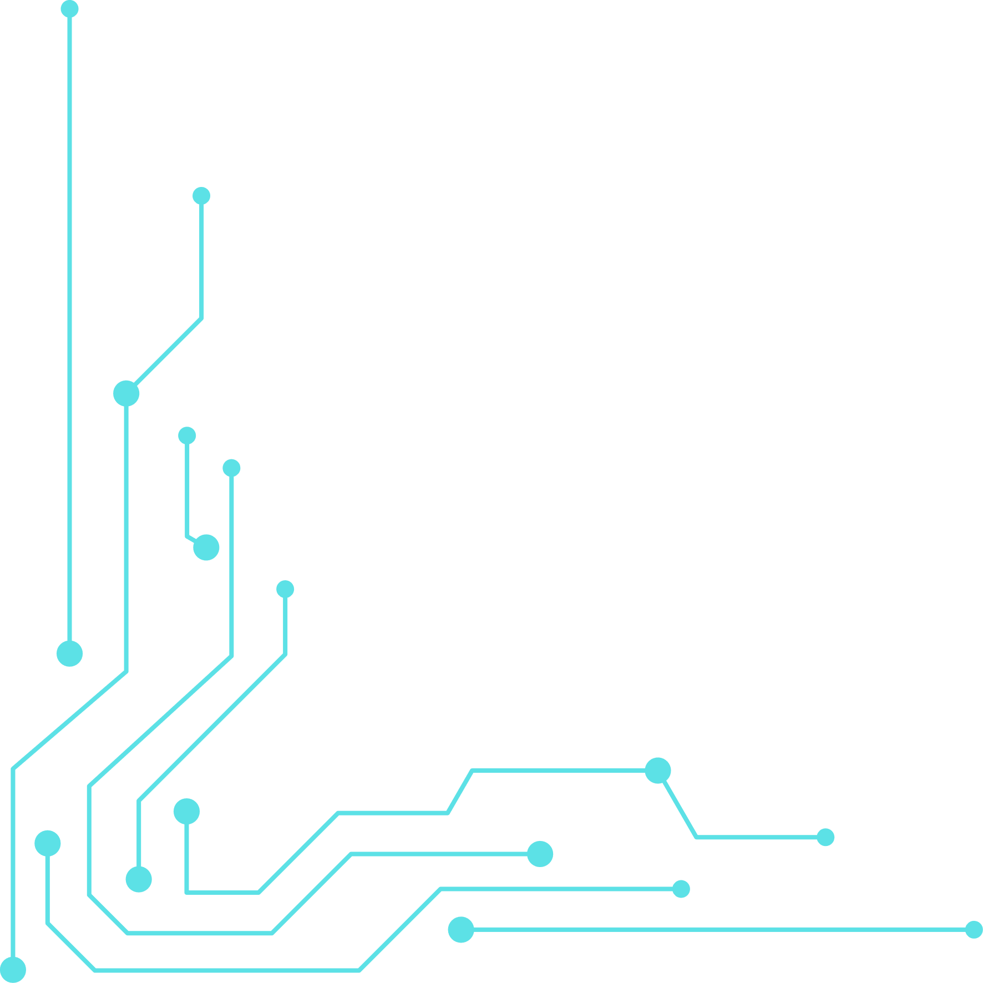
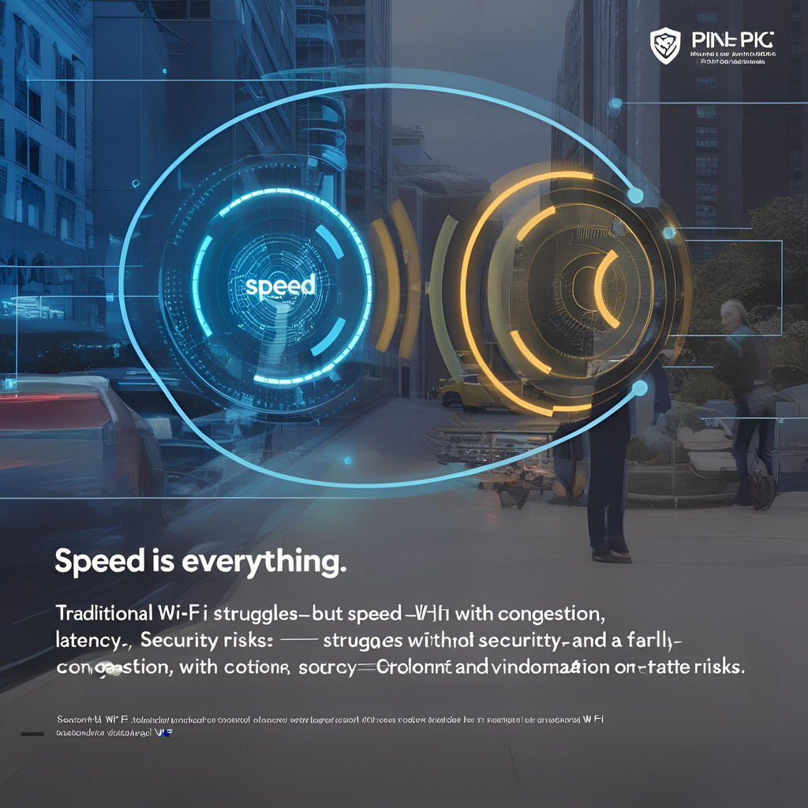
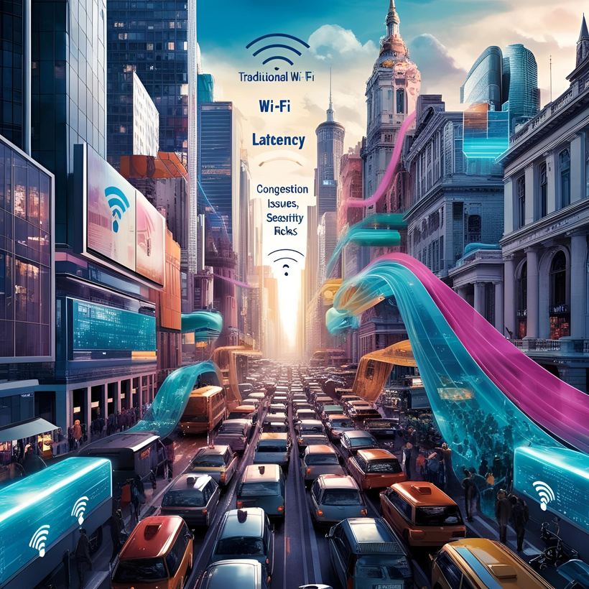
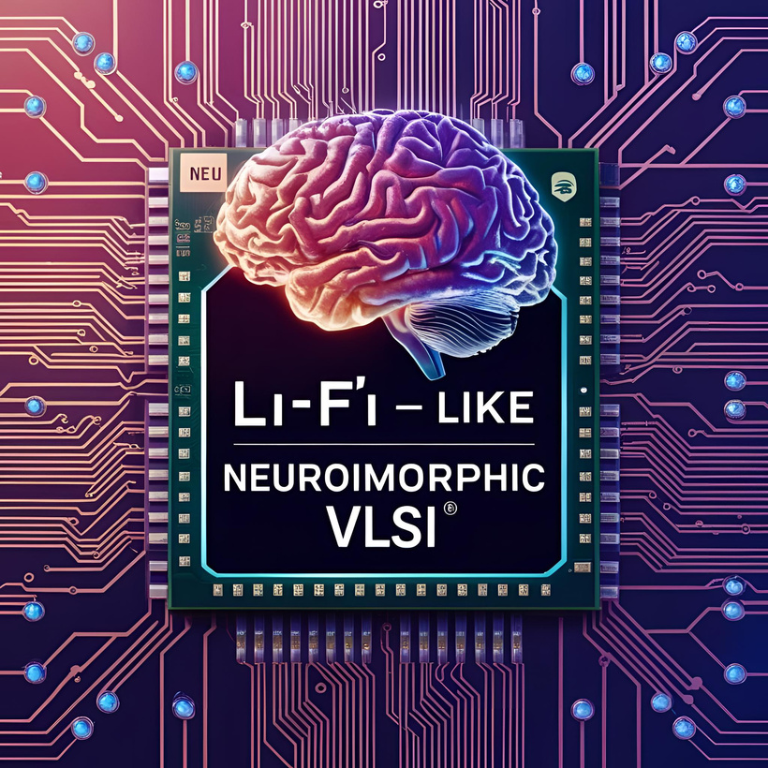
ABSTRACT
"BRAINS ON A CHIP: HOW NEUROMORPHIC VLSI SUPERCHARGES LI-FI!"
In today’s world, speed is everything—but traditional wi-fi struggles with congestion, latency, and security risks.Li-fi, a revolutionary light-based wireless communication that is 100 times faster and more secure than wi-fi. But speed alone isn’t enough! What if li-fi could think, adapt, and process data like the human brain?
That’s where neuromorphic vlsi comes in! Inspired by the brain’s neural processing,these advanced chips make li-fi smarter—enabling real-time decision-making, adaptive learning, and energy efficiency.
This breakthrough can transform industries like smart cities, healthcare, and intelligent transportation systems. Our presentation explores how neuromorphic VLSI enhances li-fi, making it not just faster, but smarter! We dive into the technology, applications, and future innovations shaping the next era of communication.

Slide 3
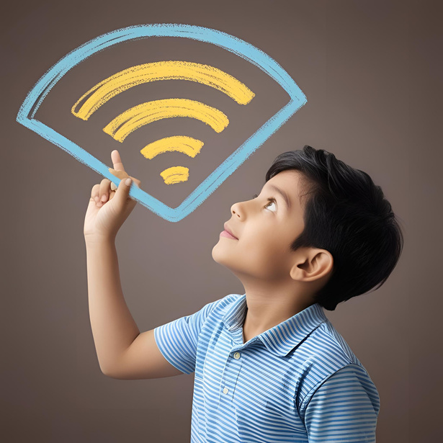
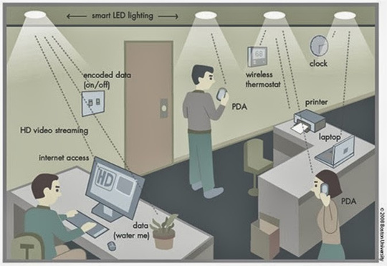

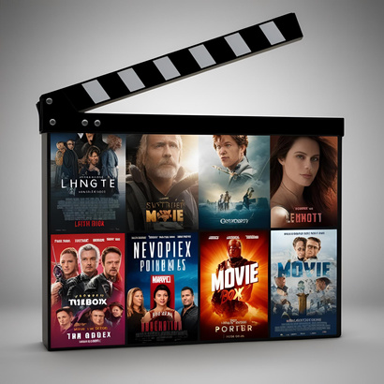
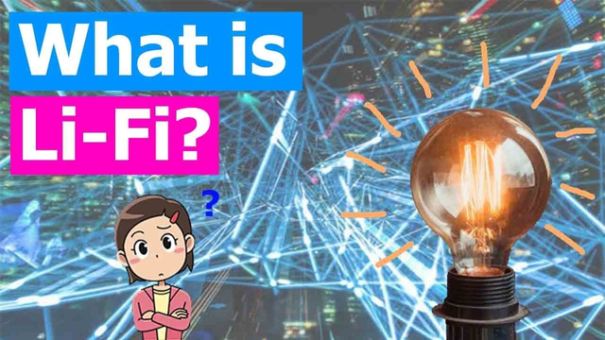
INTRODUCTION
Imagine a World Without Wi-Fi... But 100x Faster!
LIFI

Slide 4
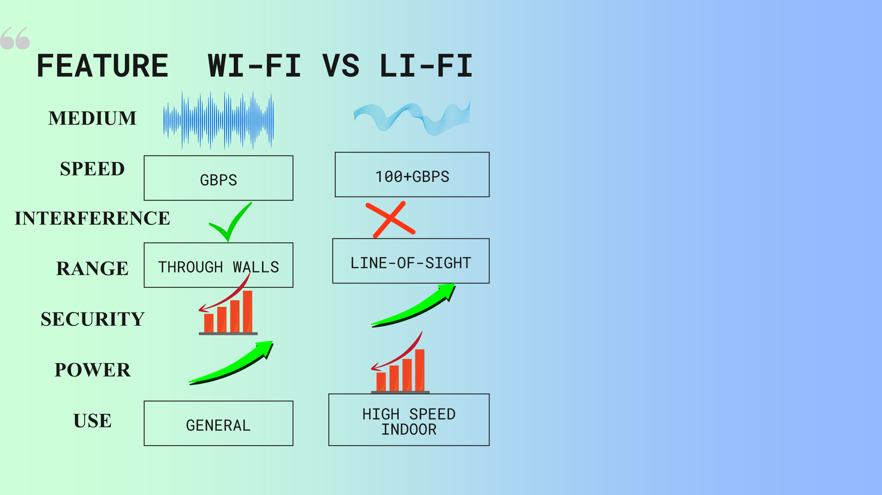
Existing Systems (Wi-Fi vs Li-Fi) "Wi-Fi Walks, Li-Fi Flies! The Evolution of Wireless Communication“

Slide 5
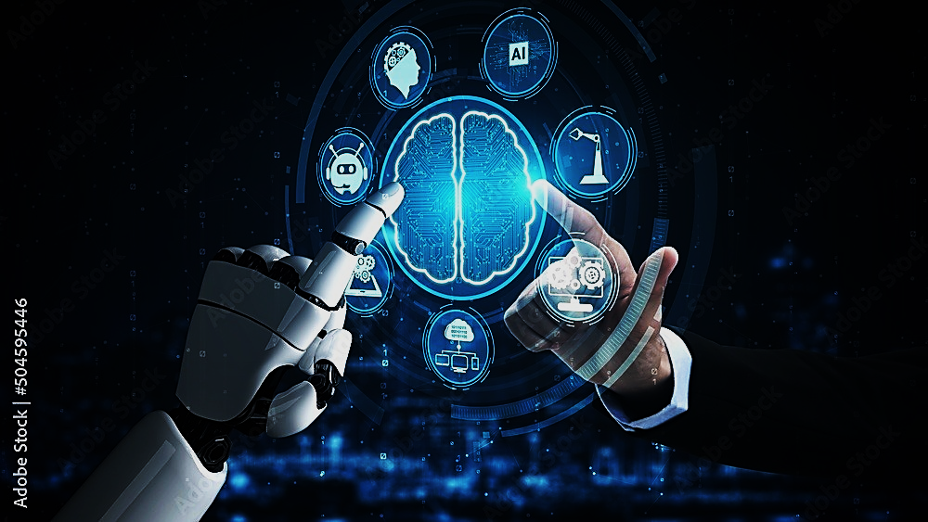
Problem Statement "Fast, But Not Smart Enough: The Missing Piece in Li-Fi"

Slide 6
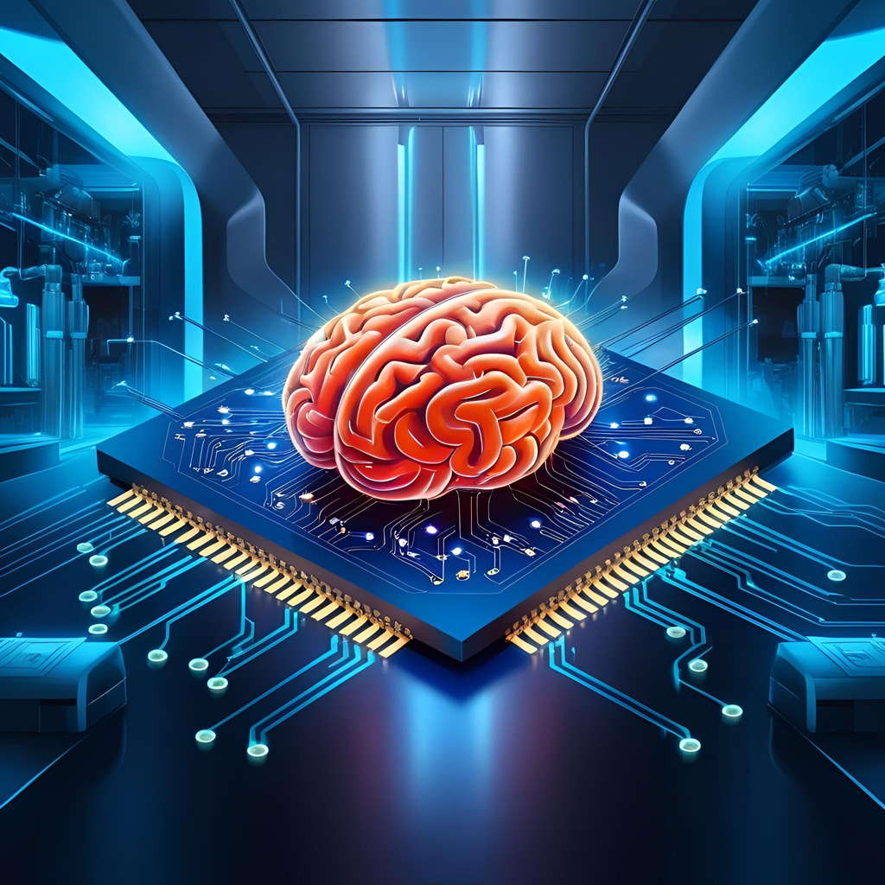
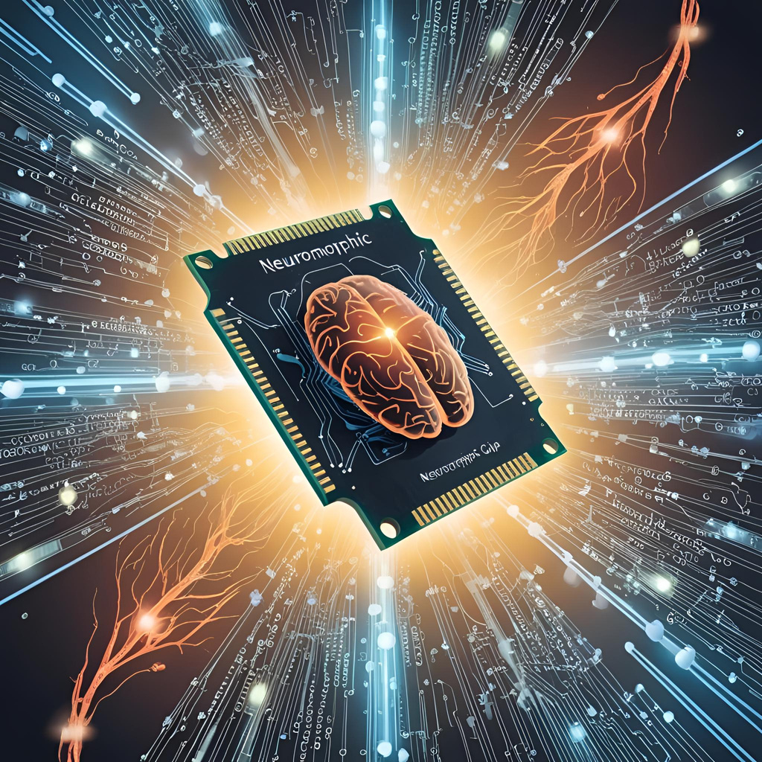
Proposed Methodology "Merging the Human Brain with Light: The Magic of Neuromorphic VLSI"

Slide 7
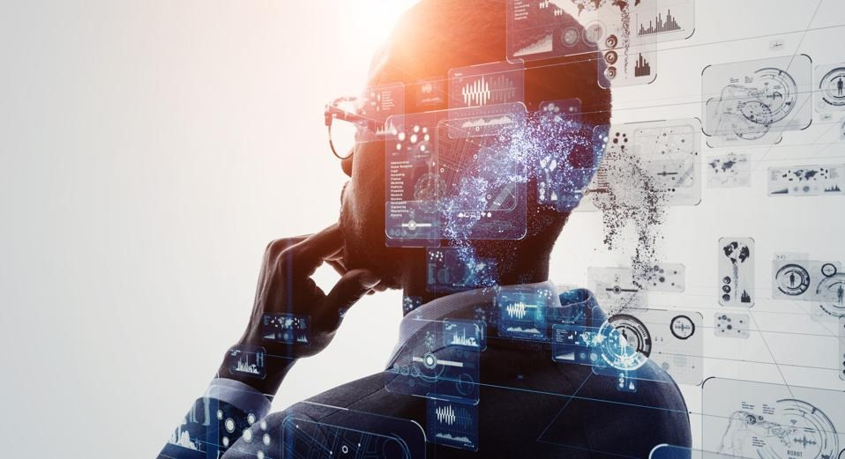
What is Neuromorphic VLSI? "Chips That Think: The Rise of Brain-Inspired Processors"

Slide 8
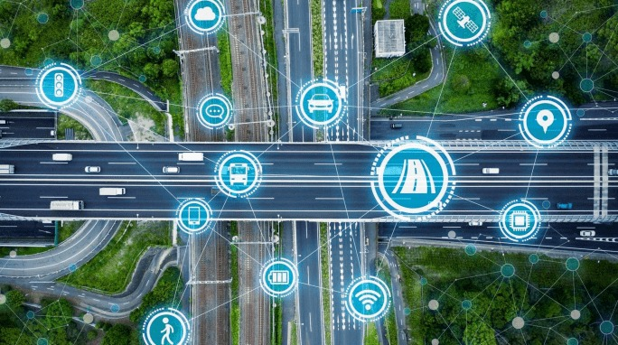
How Neuromorphic VLSI Enhances Li-Fi?“ From Just Fast to Super-Intelligent: Why Li-Fi Needs Neuromorphic VLSI"

Slide 9
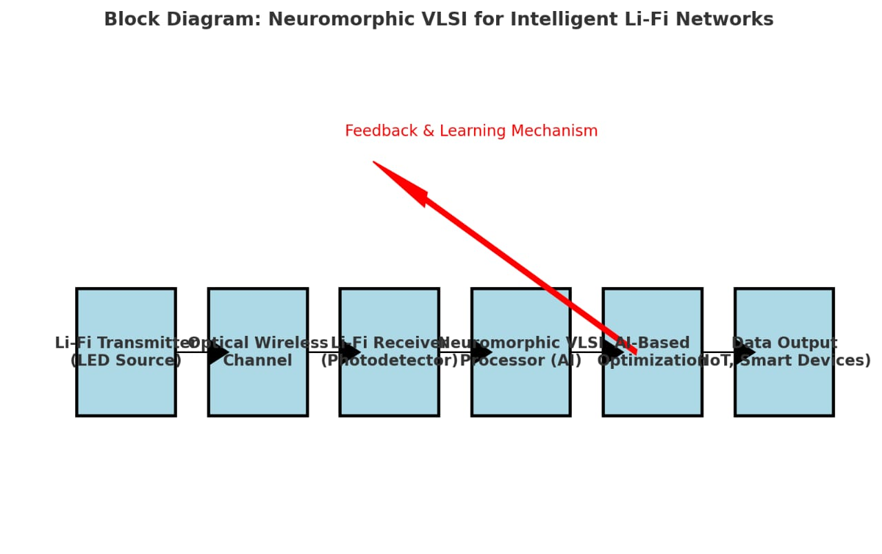
Block Diagram of the System "The Blueprint of the Future: How Our System Works!"

Slide 10
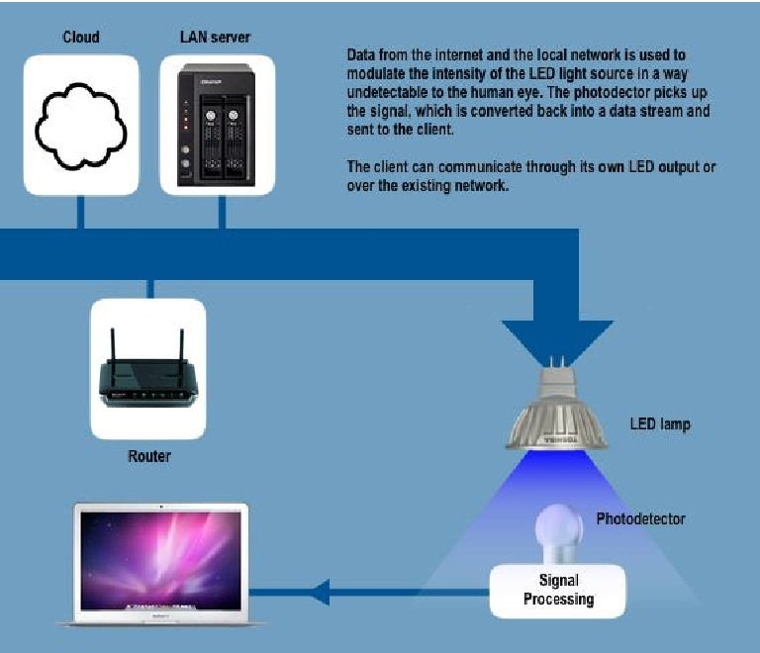

Slide 11
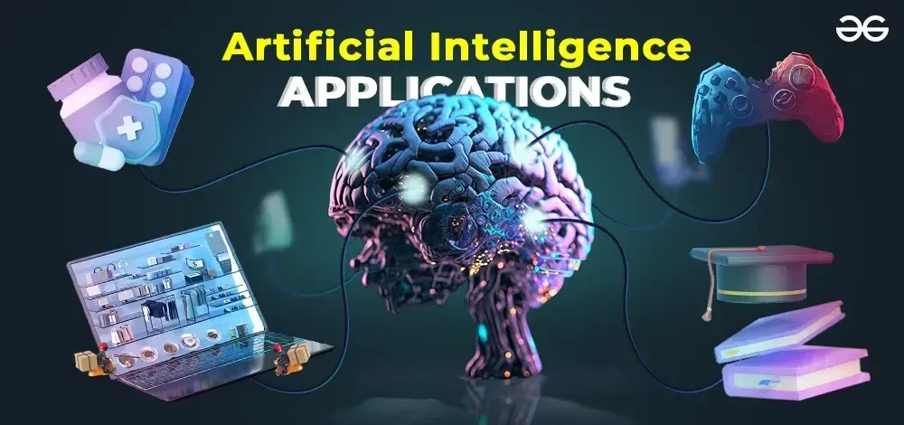
Required Components: "Building Blocks of an Ultra-Intelligent Li-Fi Network"

Slide 12
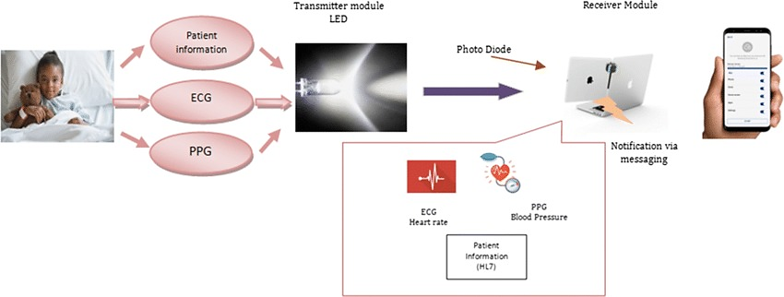
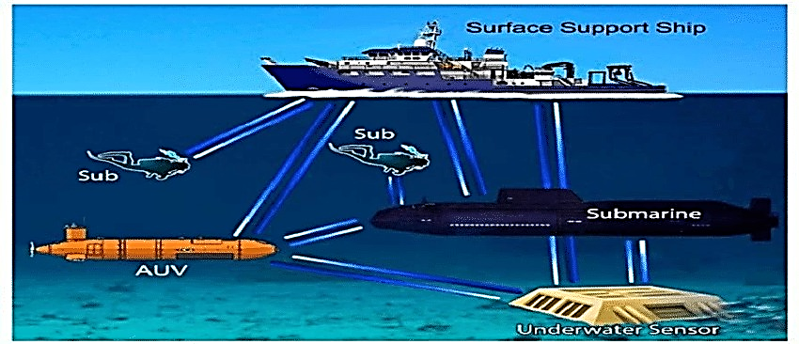
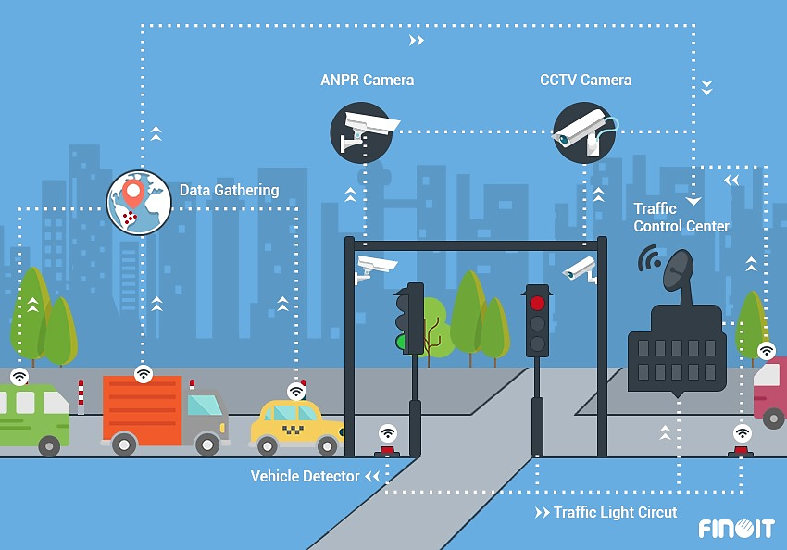
Real-World Applications
"From Smart Cities to Space: Where This Tech Will Rule!"

Slide 13

Future Research & Companies Working on This"Big Tech’s Next Bet: The Race to Own the Future of Communication"

Slide 14



Conclusion & Thank You"The Future is Bright… Literally! Welcome to the Li-Fi Revolution"

Slide 15




Thank you

